Slide 1







HackEra
Sponsored by

Slide 2

Byte bEETLES
Sanjay Ghodawat University
Team details:-
Muskan Latkar (Phone no. and email)
2. Mansi Nair
3. Anishka Jain
4. Palak Jain

Slide 3


Welcome to Your Travel Companion
FlyAway
Welcome to our travel website, where you can find the perfect vacation. We offer a wide variety of destinations, experiences, and travel tips.

Slide 4



Featured Destinations
Tropical Paradise
Charming Villages
Vibrant Cities
Explore quaint villages, picturesque landscapes, and enjoy local cuisine.
Experience bustling city life, world-class dining, and vibrant nightlife.
Relax on pristine beaches, swim in turquoise waters, and soak up the sun.

Slide 5
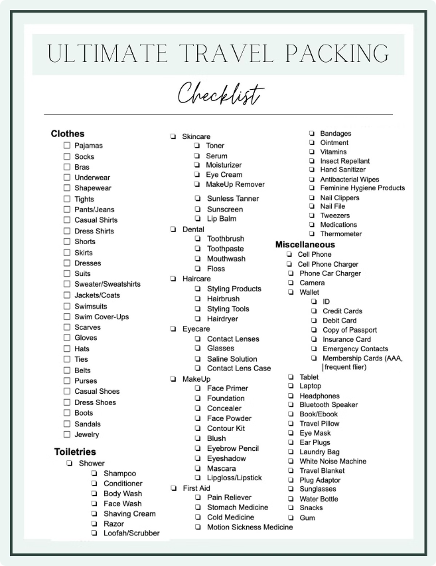
Plan Your Trip
Choose Your Destination
Browse our curated collection of destinations based on your interests
Select Your Dates
Enter your preferred travel dates to view available options and prices.
Book Your Flight & Accommodation
Secure your flights and accommodation through our reliable booking partners.
Plan Your Itinerary
Customize your itinerary with activities, tours, and experiences that suit your preferences

Slide 7
IMPORTANT INSTRUCTIONS:
Please ensure below pointers are met while submitting the Idea PPT:
1.Kindly keep the maximum slides limit up to six (6). ( excluding this slide)
2. Try to avoid paragraphs and post your idea in points /diagrams / Infographics /pictures
3. Keep your explanation precise and easy to understand
4. Idea should be unique and novel.
5. You can only use provided template for making the PPT without changing the idea details pointers (mentioned in previous slides).
6. You need to save the file in PDF and upload the same on google form. No PPT, Word Doc or any other format will be supported.
Note - You have to delete this slide (Important Pointers) when you upload the details of your idea in Google forms.

